Slide 1

DBA5103
Operations Research and Analytics
Zhenyu Hu
Semester I, 2026/2027

Slide 2
Markdown Management

Slide 3
Selling Seasonal Products
Challenges in selling fashion products
  Short selling season
    About several weeks (and it is getting shorter and shorter)
    Obsolescence after the season
  Volatile market conditions
    Difficult to predict the trend in advance
    Erratic demand: “hit” items sell out quickly while “dogs” sell slowly
    Lack of experience or historical data
  Rigid supply chains
    Long procurement lead time (several months) due to out-sourcing, etc.
    Product line and quantity commitment well in advance of the selling season
Examples of seasonal products
  Apparel, IT Products

Slide 4
Markdown
Inventory is determined before the selling season begins
Once the season begins, the only thing we can control is price
Markdown: dynamically reduce price to boost demand and increase revenue
“Retailers hate markdowns. Discount an item too late, and stores are stuck with truckloads of inventory. Too early, and they loose profits as people snap up items thrown on the bargain table prematurely …”
Wall Street Journal, Aug. 7, 2001

Slide 5
An Example
A stock of 2000 units of a single fashion item, no replenishment
Demand is hard to predict, limited historical data available
Pricing
  Four allowable prices: $60 (full price), $54 (90%), $48 (80%), $36 (60%)
  Start with $60 in Week 1, then mark down over time (no price increase)
15-week selling season
  Leftover items are sold to discounters for $25 per unit (salvage value)
Costs are paid (hence they are sunk)
GOAL: maximize revenue by determining the timing and magnitude of markdowns

Slide 6
Key Steps
Two key steps
  Estimation: build the demand model
    Study the historical data
    Choose a demand model and estimate parameters
  Optimize prices
Data
Information
Model
Prescription

Slide 7
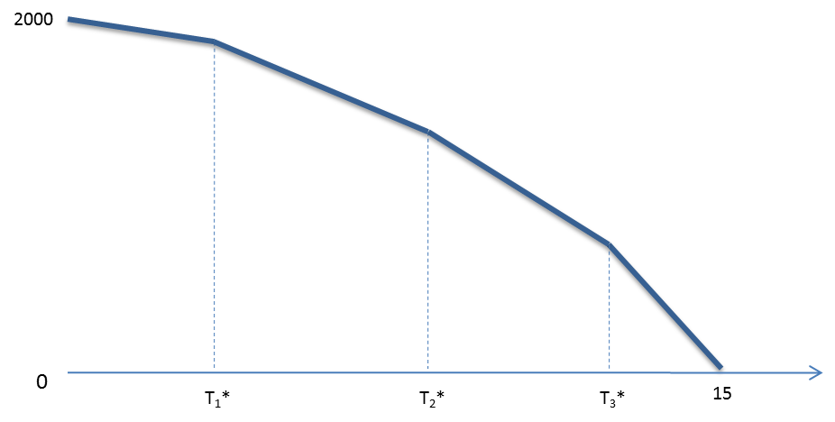
Optimization Step
Suppose we have an estimate of (weekly) demand at the four price points:
Price | $60 | $54 | $48 | $36
Demand | 125 | 162.5 | 217.5 | 348.8

Slide 8
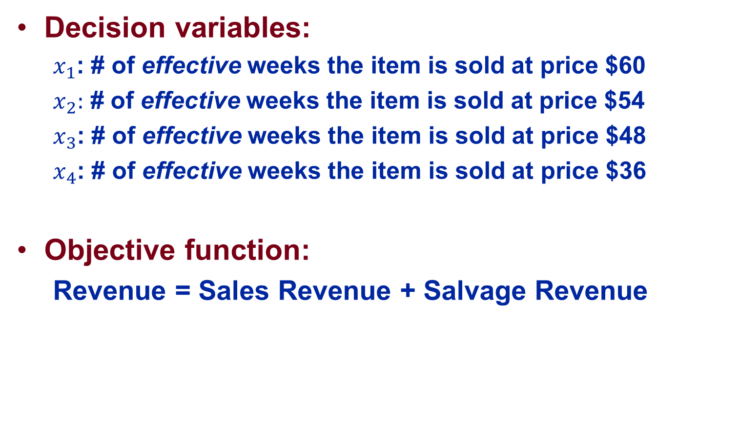
Linear Programming Formulation
Decision variables:
  $x_{1}$: # of effective weeks the item is sold at price $60
  $x_{2}:$ # of effective weeks the item is sold at price $54
  $x_{3}$: # of effective weeks the item is sold at price $48
  $x_{4}$: # of effective weeks the item is sold at price $36
Objective function:
  Revenue = Sales Revenue + Salvage Revenue
$${125∗60∗x}_{1}+162.5∗54∗x_{2}+217.5∗48∗x_{3}+348.8∗36∗x_{4}$$
+ 25*(2000 - ${125∗x}_{1}−162.5∗x_{2}−217.5∗x_{3}−348.8∗x_{4})$

Slide 9
Linear Programming Formulation
Constraints:
  Capacity constraint: sales ≤ inventory
  Time constraint: total effective weeks at all prices ≤ the selling season
  Full price in week 1:
  Non-negativity:
$${125∗x}_{1}+162.5∗x_{2}+217.5∗x_{3}+348.8∗x_{4}≤2000$$
$$x_{1}+x_{2}+x_{3}+x_{4}≤15$$
$$x_{1}≥1$$
$$x_{1},{ x}_{2}, x_{3}, x_{4}≥0$$

Slide 10
Sensitivity Analysis
Effects of initial inventory
Effects of selling horizon
Effects of good market / bad market

Slide 11
Improving the Markdown Strategy
Dynamic adjustment
More discount levels
Consider future uncertainties
Data
Information
Model
Prescription
Simulator

Slide 12
Uncertain Linear Program

Slide 13
Incomplete Knowledge of Data
Available resources, prices
Coefficient matrix (technology matrix / bill of material)

Slide 14
What’s Different?
In sensitivity analysis:
Decision making under uncertainty:
Data 1
Decision 1
Performance 1
Data 2
Decision 2
Performance 2
Data 1
Data 1
Performance 1
Decision
Data 2
Data 2
Performance 2

Slide 15
Production Example Revisited Again
What type of industry faces lots of uncertainty in production?
  Bio-chemical
  Pharmaceutical
  Agricultural
Source of uncertainty
  Supply
  Production process

Slide 16

Example

Slide 17
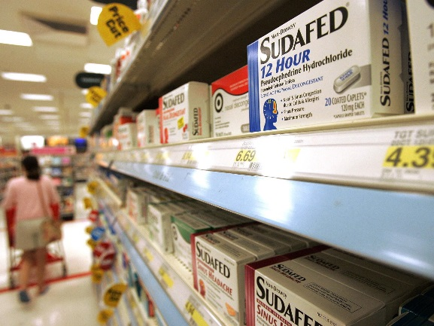



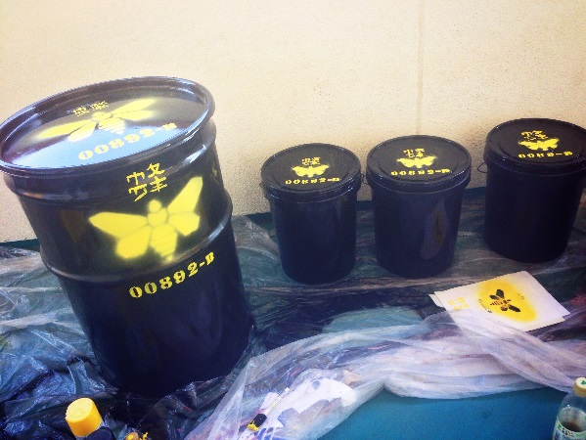
Supply Chain in Breaking Bad
Production
Uncertainty
Price Fixed
Dual Sourcing Strategy
Committed Contract
https://www.youtube.com/watch?v=-iUVhv_sDhA&list=PLOhe6-yzmaj-g3paSmTbxv_fqTk1z0VU8&index=27

Slide 18
Production Problem
Product characteristic
Supply characteristic
Resource characteristic
 | Price | Content of M | Manpower | Equip | Cost
Drug M | $6200 | 50% | 90h | 40h | $700
Raw Material | Cost | Content of M
Raw 1 | $100.00 | 1%
Raw 2 | $199.90 | 2%
Budget | Manpower | Equip | Storage Capacity
$100,000 | 2000h | 800h | 1,000kg

Slide 19
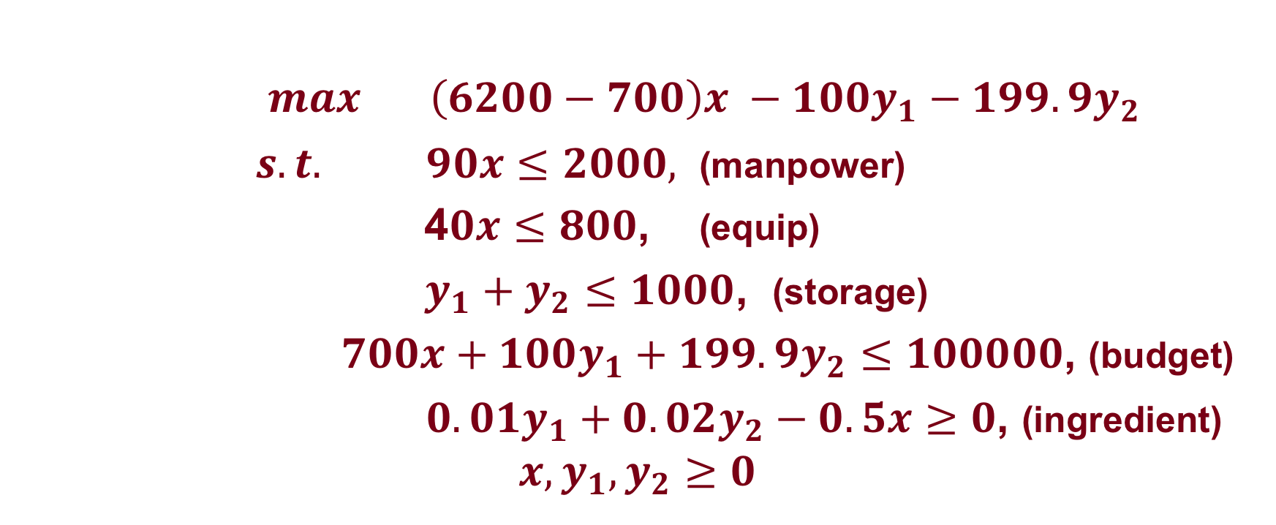
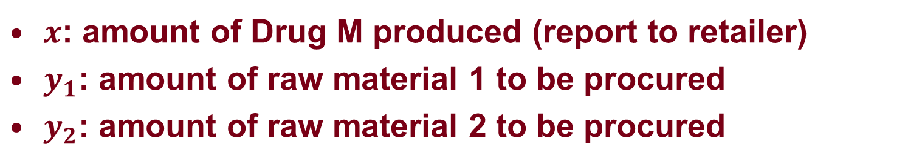
Model
$x$: amount of Drug M produced (report to retailer)
$y_{1}$: amount of raw material 1 to be procured
$y_{2}$: amount of raw material 2 to be procured
$max \left(6200−700\right)x −100y_{1}−199.9y_{2}$
$s.t. 90x≤2000,$ (manpower)
4$0x≤800$, (equip)
$y_{1}+y_{2}≤1000$, (storage)
$700x+100y_{1}+199.9y_{2}≤100000$, (budget)
${0.01y}_{1}+{0.02y}_{2}−0.5x≥0$, (ingredient)
$$x,y_{1},y_{2}≥0$$

Slide 20
Solution: $8819.66 (8.8% return)
Primal Solution
Dual Solution
Drug M | Raw 1 | Raw 2
17.55 | 0 | 438.79
Budget | Manpower | Equip | Storage Capacity | Ingredient M
0.088 | 0 | 0 | 0 | -10876.5

Slide 21
Data Uncertainty
Supply characteristic
  The exact value of the percentage of M is unknown until production is finished.
Original Solution:
If raw 1 realizes to be 0.995% and raw 2 realizes to be 1.96%, then 438.79*1.96%=8.6 < 17.55*50%=8.775!
Raw Material | Content of M | Variability Range
Raw 1 | 1% | [0.995%, 1.005%]
Raw 2 | 2% | [1.96%, 2.04%]
Drug M | Raw 1 | Raw 2
17.55 | 0 | 438.79

Slide 22
Remedy
Ad-hoc remedy: since we only have 438.79*1.96% amount of ingredient M, we adjust production quantities to 17.2 < 17.55.
Drawbacks:
  Commitment to demands
  Profit loss: $6889, 22% less than $8820.

Slide 23
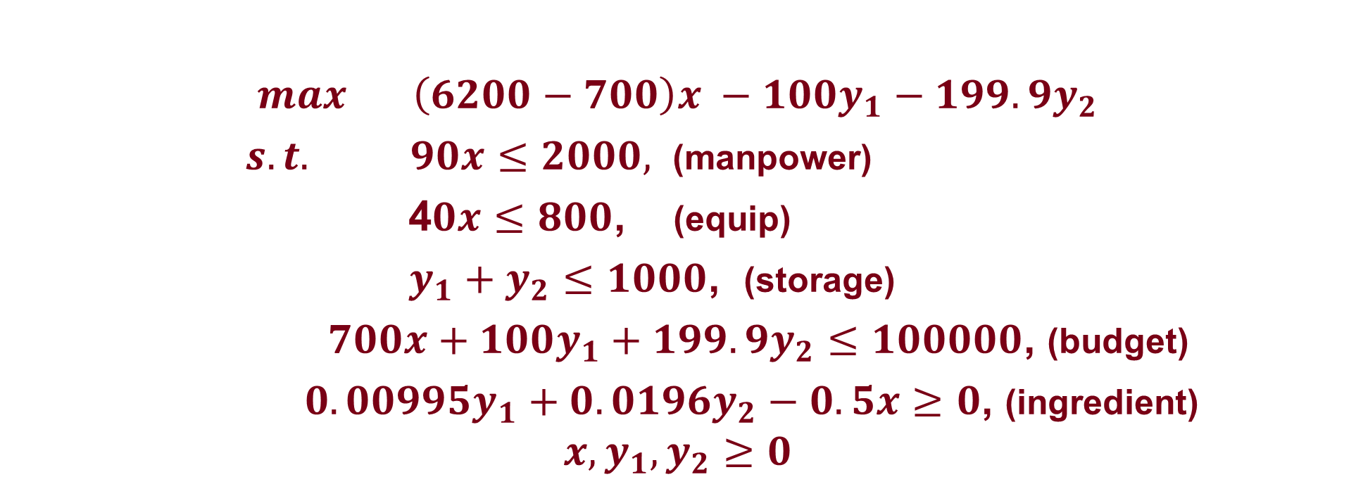
A Robust Optimization Perspective
Prepare for the worst.
  When formulating the problem, use the realization raw 1: 0.995% and raw 2: 1.96%.
$max \left(6200−700\right)x −100y_{1}−199.9y_{2}$
$s.t. 90x≤2000,$ (manpower)
4$0x≤800$, (equip)
$y_{1}+y_{2}≤1000$, (storage)
$700x+100y_{1}+199.9y_{2}≤100000$, (budget)
${0.00995y}_{1}+{0.0196y}_{2}−0.5x≥0$, (ingredient)
$$x,y_{1},y_{2}≥0$$

Slide 24
A Robust Optimization Perspective
For any realization of raw 1 and raw 2, solution is always feasible:
  Suppose content of M in raw 1 turns out to be 1% and content of M in raw 2 turns out to be 2%. Then
Prevent loss:
  In the worst case: $8294.57, only 5.95% less than $8820
Drug M | Raw 1 | Raw 2
17.47 | 877.732 | 0
877.732*1% = 8.777 > 17.47*50% = 8.735

Slide 25
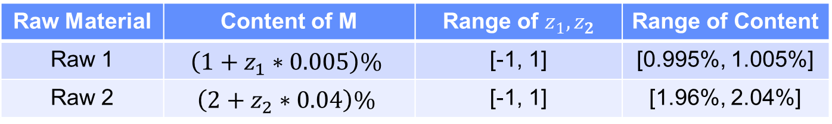
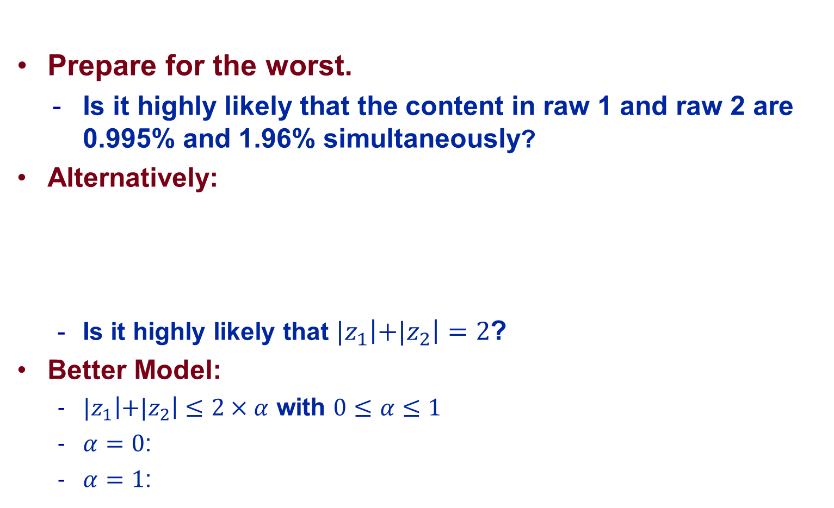
Controlling Conservativeness
Prepare for the worst.
  Is it highly likely that the content in raw 1 and raw 2 are 0.995% and 1.96% simultaneously?
Alternatively:
  Is it highly likely that ${|z}_{1}\left|+{|z}_{2}\right|=2$?
Better Model:
  ${|z}_{1}\left|+{|z}_{2}\right|≤2×α$ with $0≤α≤1$
  $α=0$:
  $α=1$:
Raw Material | Content of M | Range of $z_{1},z_{2}$ | Range of Content
Raw 1 | $$\left({1+z}_{1}∗0.005\right)\%$$ | [-1, 1] | [0.995%, 1.005%]
Raw 2 | $$\left({2+z}_{2}∗0.04\right)\%$$ | [-1, 1] | [1.96%, 2.04%]

Slide 26
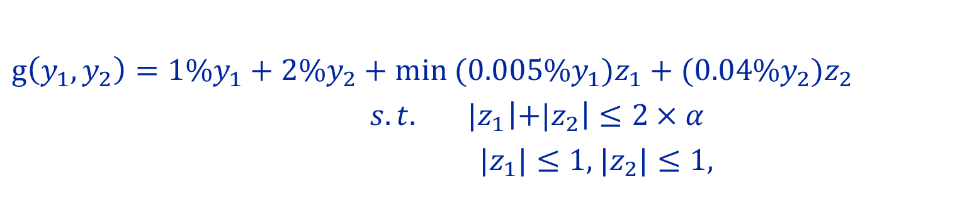
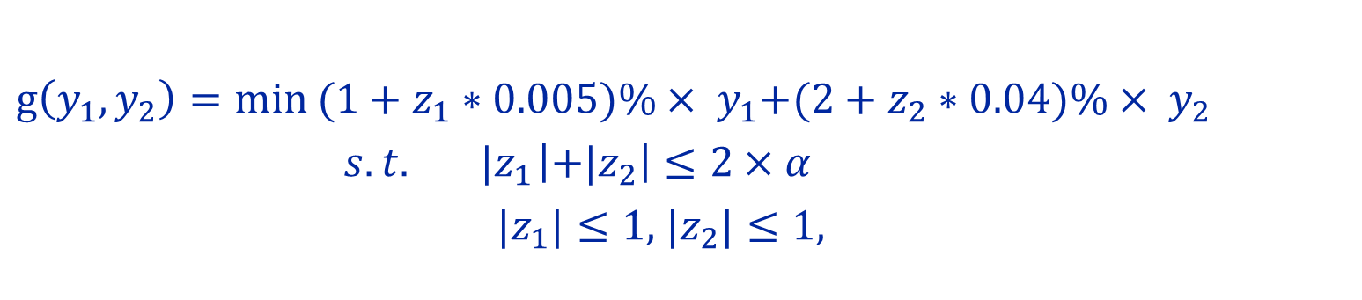
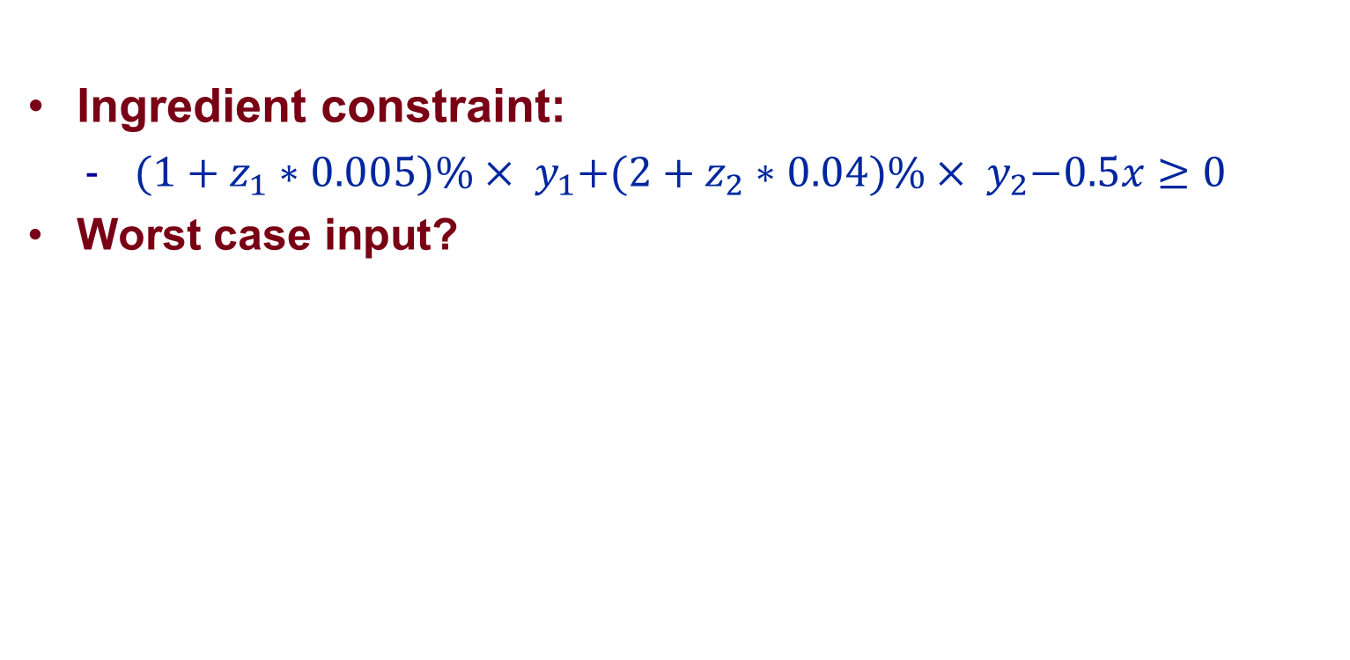
Controlling Conservativeness
Ingredient constraint:
  ${(1+z_{1}∗0.005)\%× y}_{1}+{(2+z_{2}∗0.04)\%× y}_{2}−0.5x≥0$
Worst case input?
$g\left(y_{1},y_{2}\right)=min{{(1+z_{1}∗0.005)\%× y}_{1}+{(2+z_{2}∗0.04)\%× y}_{2}}$
$s.t. { |z}_{1}\left|+{|z}_{2}\right|≤2×α$
${ |z}_{1}|≤1$, |$z_{2}|≤1$,
${g\left(y_{1},y_{2}\right)=1\%y}_{1}+2\%y_{2}+min{{(0.005\%y}_{1})z_{1}+{(0.04\%y}_{2})z_{2}}$
$s.t. { |z}_{1}\left|+{|z}_{2}\right|≤2×α$
${ |z}_{1}|≤1$, $|z_{2}|≤1$,

Slide 27
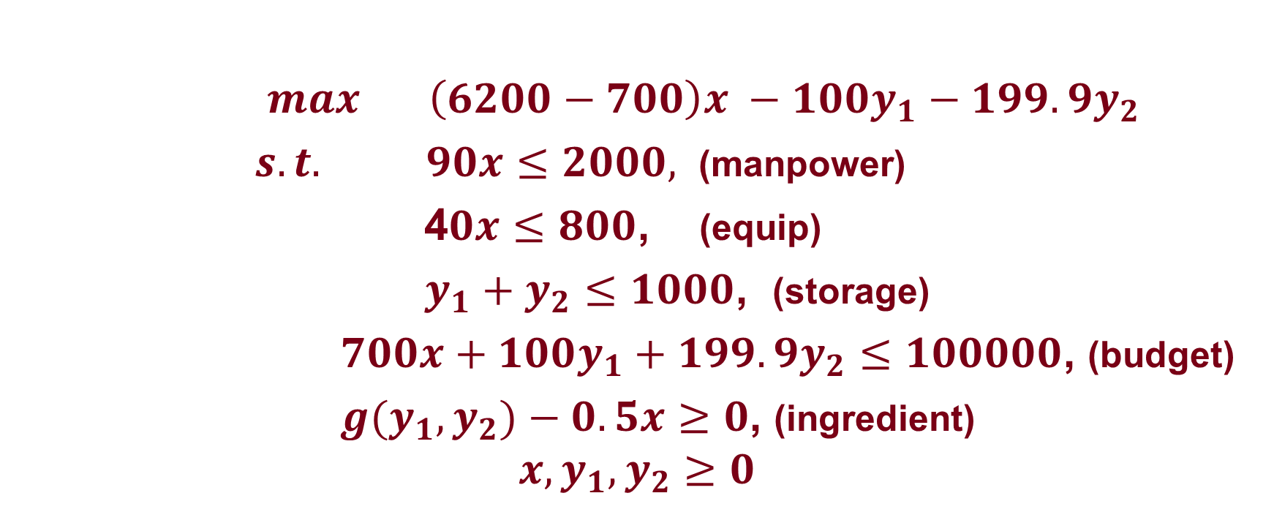
Model with Conservativeness Control
$max \left(6200−700\right)x −100y_{1}−199.9y_{2}$
$s.t. 90x≤2000,$ (manpower)
4$0x≤800$, (equip)
$y_{1}+y_{2}≤1000$, (storage)
$700x+100y_{1}+199.9y_{2}≤100000$, (budget)
${g(y}_{1},y_{2})−0.5x≥0$, (ingredient)
$$x,y_{1},y_{2}≥0$$

Slide 28
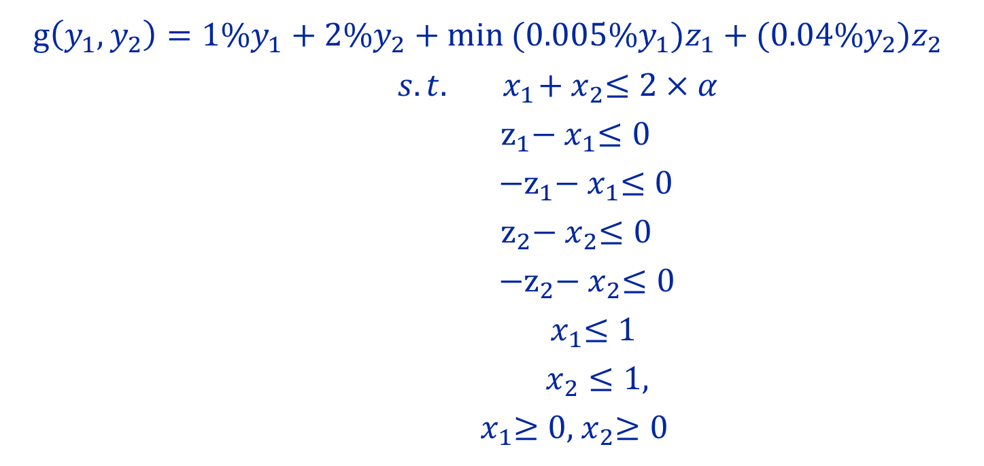

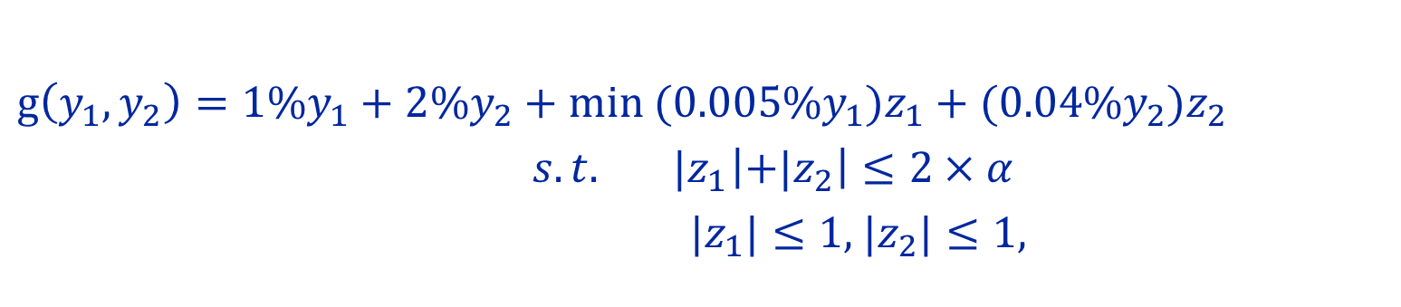






LP Formulation
Worst case input
${g\left(y_{1},y_{2}\right)=1\%y}_{1}+2\%y_{2}+min{{(0.005\%y}_{1})z_{1}+{(0.04\%y}_{2})z_{2}}$
$s.t. { |z}_{1}\left|+{|z}_{2}\right|≤2×α$
${ |z}_{1}|≤1$, $|z_{2}|≤1$,
${g\left(y_{1},y_{2}\right)=1\%y}_{1}+2\%y_{2}+min{{(0.005\%y}_{1})z_{1}+{(0.04\%y}_{2})z_{2}}$
$s.t.{ x}_{1}+{ x}_{2}≤2×α$
$z_{1}−{ x}_{1}≤0$
${−z}_{1}−{ x}_{1}≤0$
$z_{2}−{ x}_{2}≤0$
${−z}_{2}−{ x}_{2}≤0$
${ x}_{1}≤1$
$x_{2}≤1$,
${ x}_{1}≥0$,${ x}_{2}≥0$
$$p_{1}$$
$$p_{2}$$
$$p_{3}$$
$$p_{4}$$
$$p_{5}$$
$$p_{6}$$
$$p_{7}$$

Slide 29
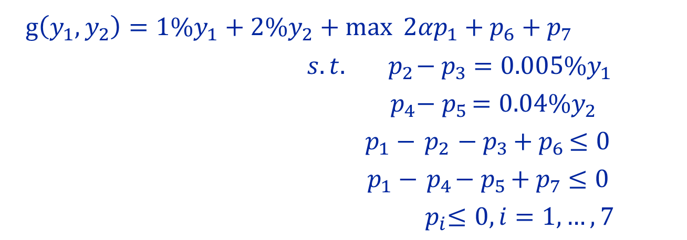
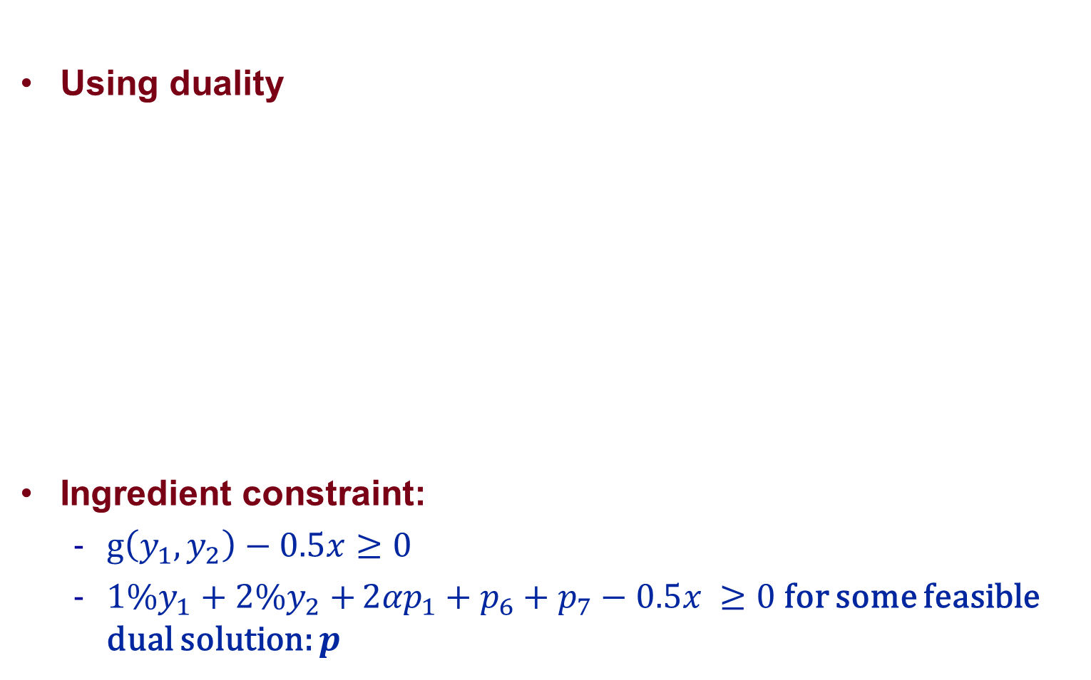
LP Formulation
Using duality
Ingredient constraint:
  $g\left(y_{1},y_{2}\right)−0.5x≥0$
  ${1\%y}_{1}+2\%y_{2}+{2{αp}_{1}+p_{6}}+p_{7}−0.5x ≥0$ for some feasible dual solution: $p$
${g\left(y_{1},y_{2}\right)=1\%y}_{1}+2\%y_{2}+max{2{αp}_{1}+p_{6}}+p_{7}$
$s.t.{ p}_{2}−{ p}_{3} ={0.005\%y}_{1}$
$p_{4}−{ p}_{5 }={0.04\%y}_{2}$
$p_{1}−{ p}_{2 }−{ p}_{3 }+{ p}_{6 }≤0$
$p_{1}−{ p}_{4}−{ p}_{5 }+{ p}_{7} ≤0$
${ p}_{i}≤0, i=1,…,7$

Slide 30
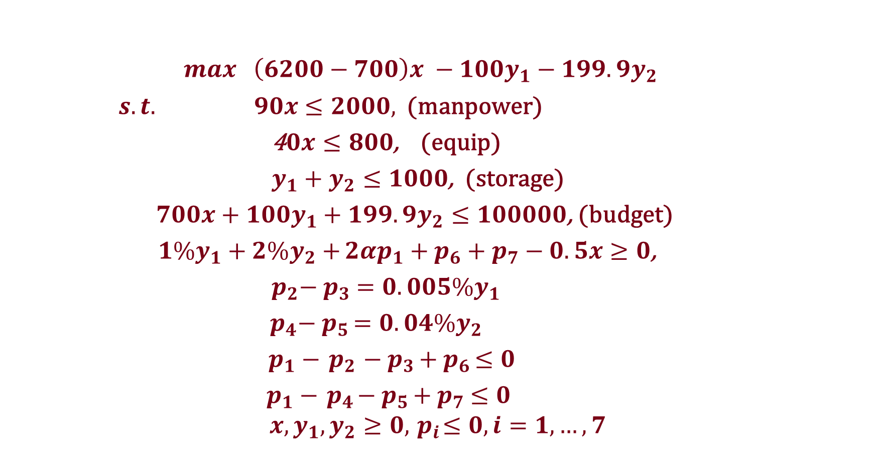
LP Formulation
$max \left(6200−700\right)x −100y_{1}−199.9y_{2}$
$s.t. 90x≤2000,$ (manpower)
4$0x≤800$, (equip)
$y_{1}+y_{2}≤1000$, (storage)
$700x+100y_{1}+199.9y_{2}≤100000$, (budget)
${1\%y}_{1}+2\%y_{2}+{2{αp}_{1}+p_{6}}+p_{7}−0.5x≥0$,
${ p}_{2}−{ p}_{3} ={0.005\%y}_{1}$
$p_{4}−{ p}_{5 }={0.04\%y}_{2}$
$p_{1}−{ p}_{2 }−{ p}_{3 }+{ p}_{6 }≤0$
$p_{1}−{ p}_{4}−{ p}_{5 }+{ p}_{7} ≤0$
$$x,y_{1},y_{2}≥0,{ p}_{i}≤0, i=1,…,7$$
Ingredient
Reference: Bertsimas and Sim, “The Price of Robustness”, 2004, Operations Research Vol. 52, No.1

